Slide 2
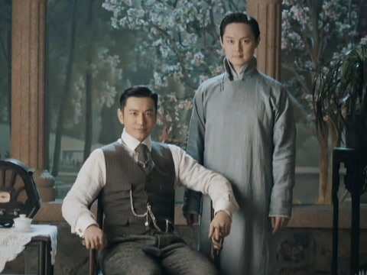
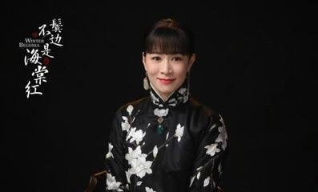
the Republic of China (1912-1949)
中华民国(1912-1949)

Slide 3
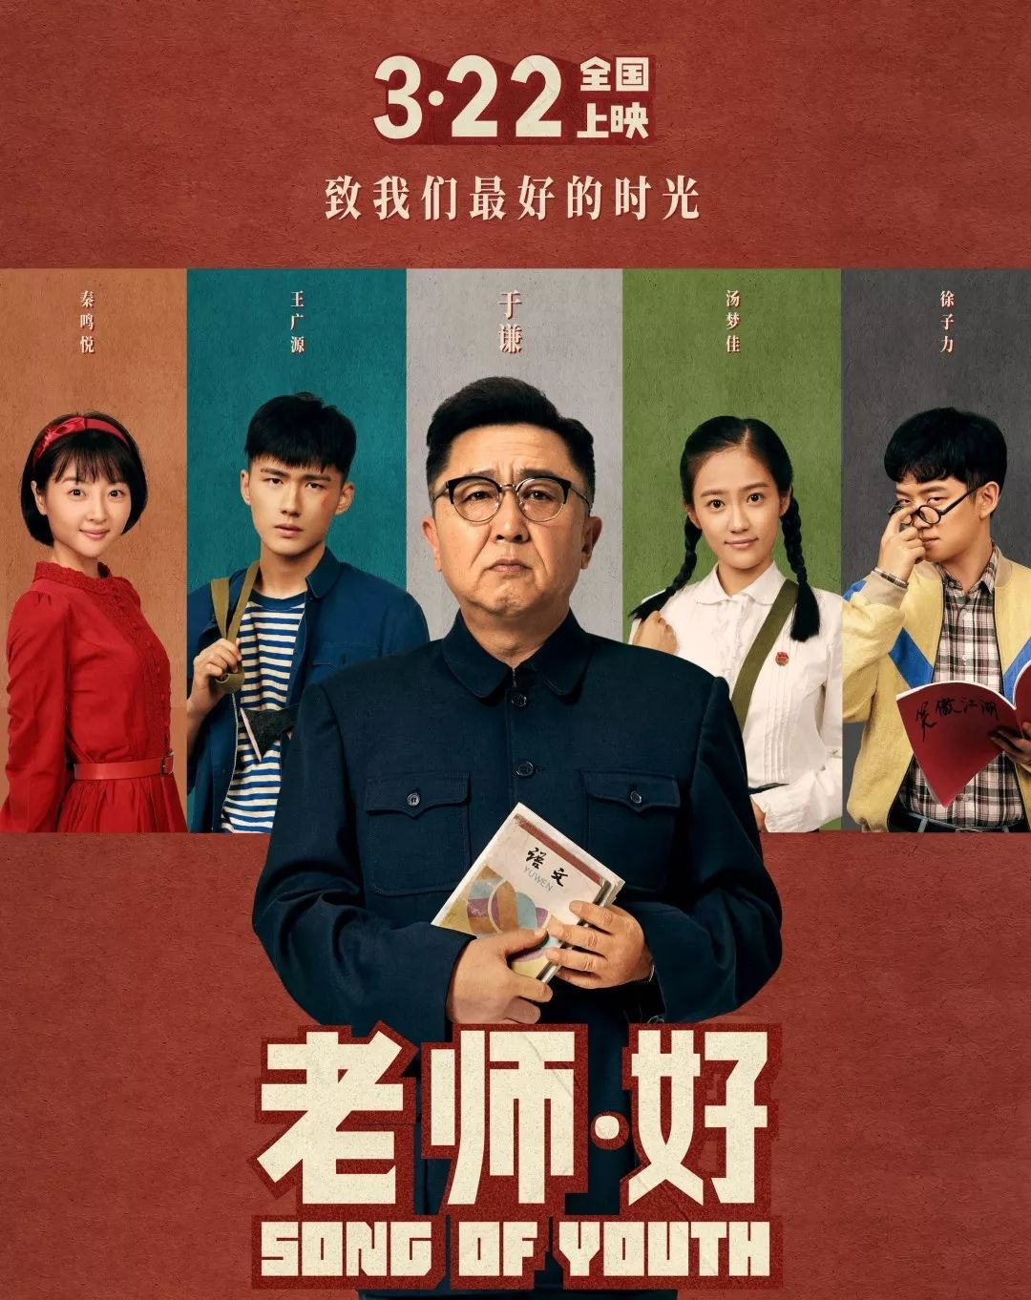
70s and 80s of the last century

Slide 4
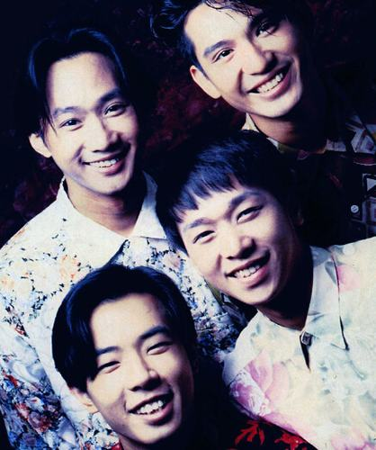
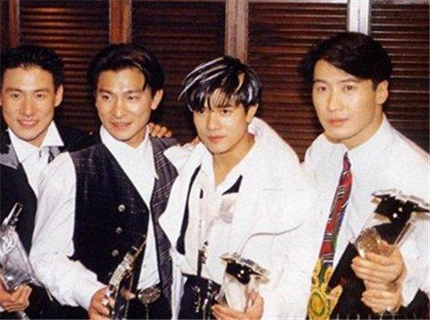
90s of the last century

Slide 5
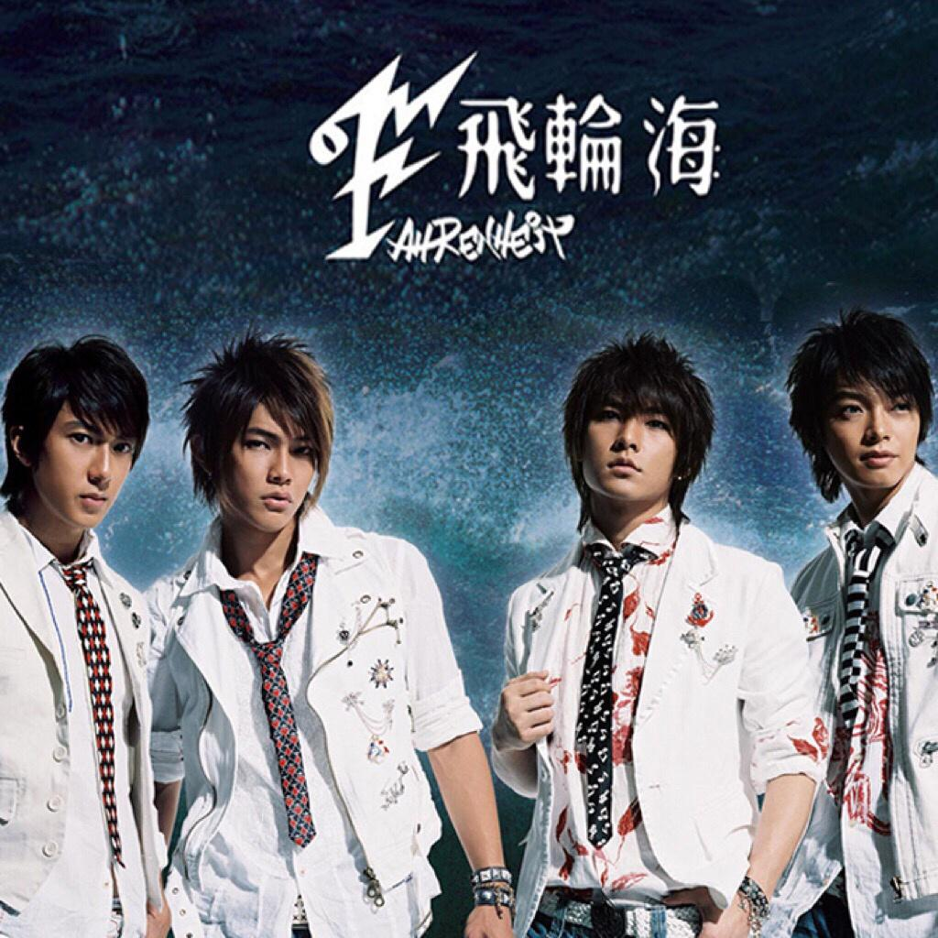
00s of this century

Slide 6
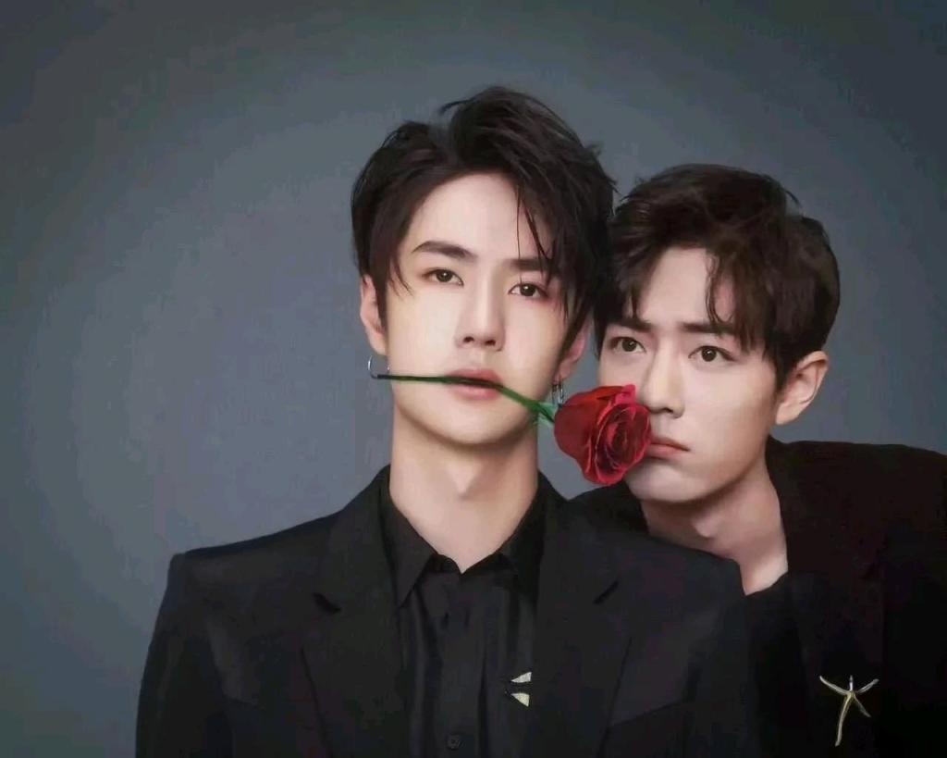
now

Slide 7
What’s your definition of fashion?
Fashion is a popular aesthetic expression at a particular time and in a specific context, especially in clothing, footwear, lifestyle, accessories, makeup, hairstyle, and body proportions.

Slide 8
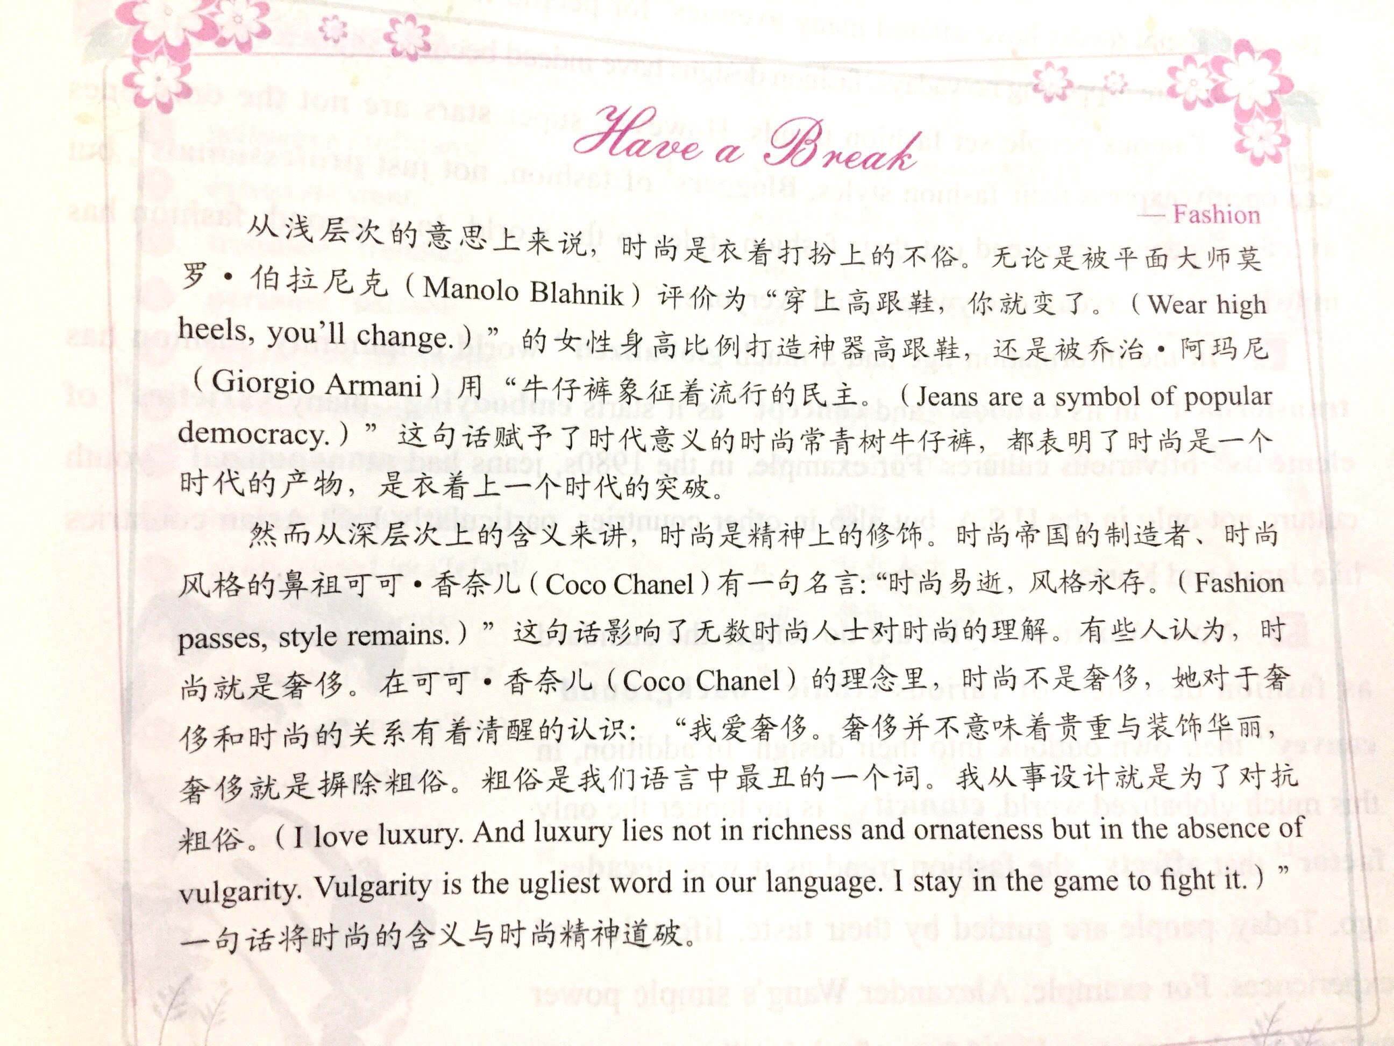

Slide 9
Do you think you are fashionable or not?

Slide 10
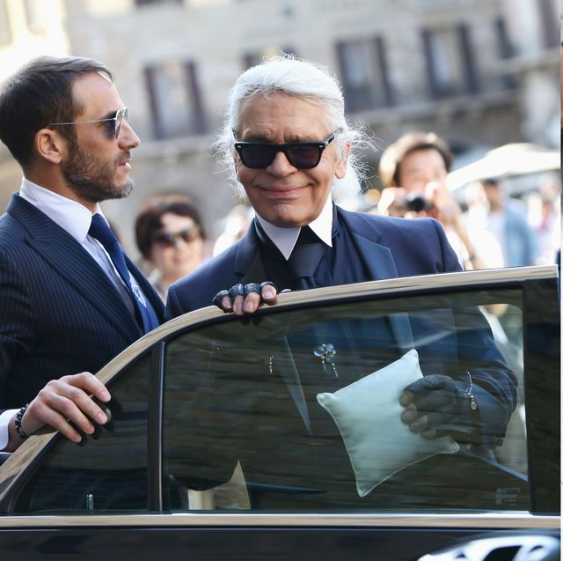
卡尔·拉格斐（德语：Karl Lagerfeld，1933年9月10日－2019年2月19日），老佛爷。

Slide 11
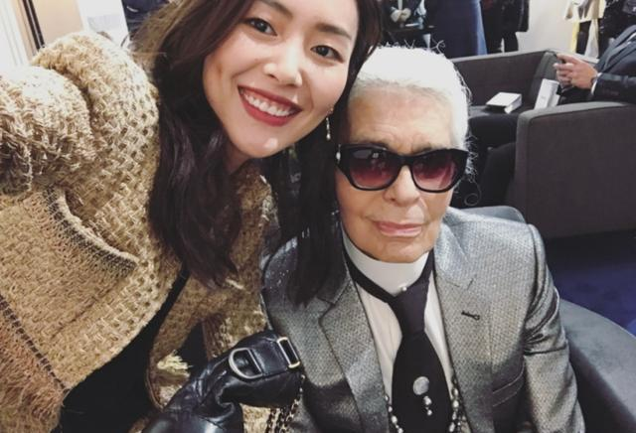
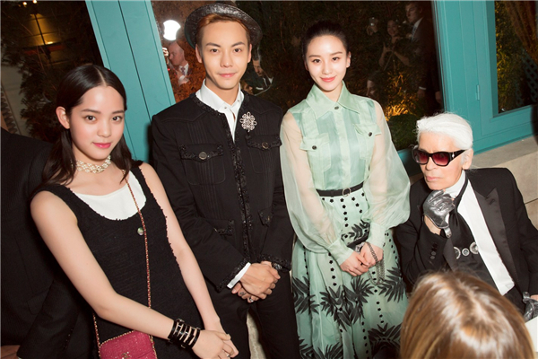

Slide 12
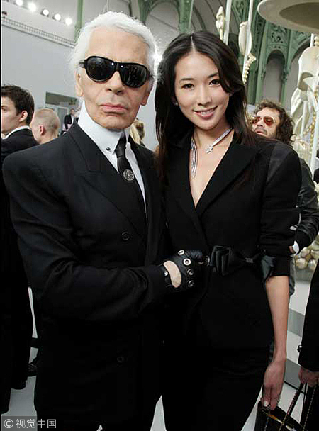
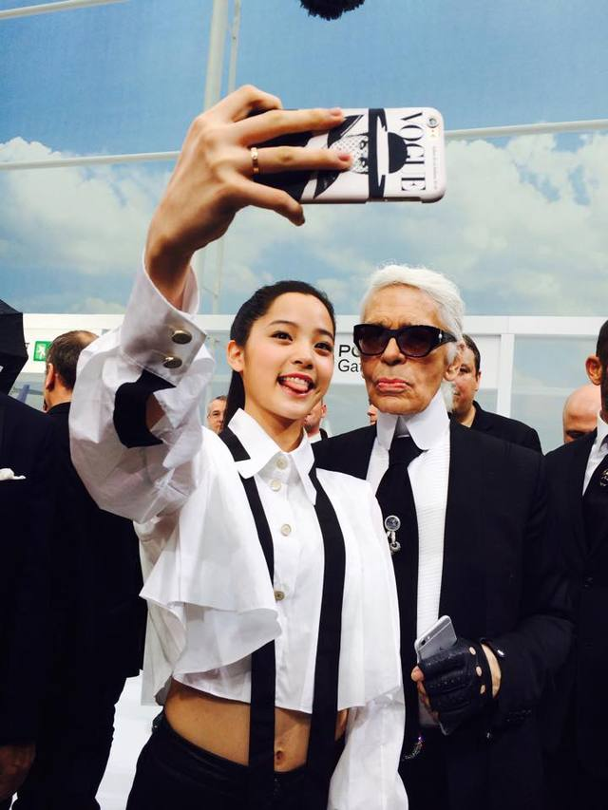

Slide 13
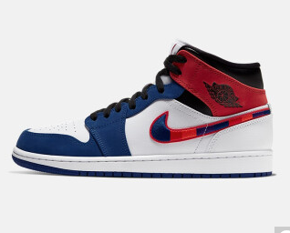

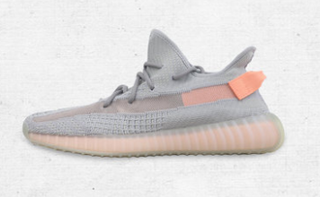
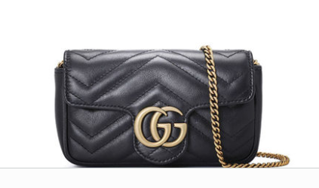

Slide 14
Do you know how to pronounce the names of some luxury brands?

Slide 15



Text A Intensive Reading
Fashion: Be Yourself!
1 fashion /'fæʃn/ n. 时尚；流行款式
2 style /staɪl/ n. 品味；方式；作风
3 surface /'sɜːfɪs/ n. 表面；表层
4 teen /tiːn/ n. 青少年（相当于teenager）
5 constantly /'kɒnstəntli/ adv. 始终；重复不断地
6 normal /'nɔːml/ adj. 正常的；一般的
7 outfit /'aʊtfɪt/ n. 全套服装
8 confidence /'kɒnfɪdəns/ n. 自信；信赖
9 internship /'ɪntɜːnʃɪp/ n. （学校或毕业生的）实习期
10 personalize /'pɜːsənəlaɪz/ v. 为个人特制或者专设
11 rush /rʌʃ/ n. （强烈感情的）迸发，涌动
New Words

Slide 16
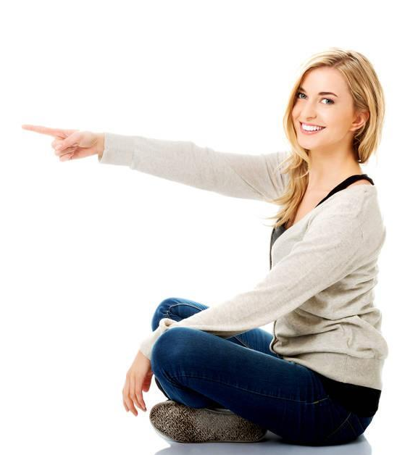
12 empowerment /ɪm'paʊəmənt/ n. 力量感
13 quirky /'kwɜːki/ adj. 奇特的；离奇的
14 crown /kraʊn/ n. 王冠；帽子
15 puzzle /'pʌzl/ n. 谜语；智力游戏
16 powerful /'paʊəfl/ adj. 强势有力的；有影响力的
17 figure /'fɪgə(r)/ v. 计算；认定
18 model /'mɒdl/ n. 模特
19 actress /'æktrəs/ n. 女演员
20 source /sɔːs/ n. 来源，出处
21 inspiration /ˌɪnspə'reɪʃn/ n. 灵感；妙计

Slide 17
Fashion: Be Yourself !
★ too... to 太……以至于
e.g. I am too tired to get up in the morning.
too… to
英语中常用的一种结构。其句型为“too + 形容词或副词 + to do”，意为“太……以至于”，在形式上是肯定的，但在意义上是否定的。
1 The thing I’ve always loved most about fashion is the power that it gives me. At moments when I don’t feel like I have a voice, the clothes that I wear give me one. When I’m too afraid to speak out, my style² can speak for me. Fashion is more than what’s on the surface³; it gives me a chance to share a different part of myself with the world.
★ feel like 想要；看上去；感觉
e.g. Do you feel like you should change your clothes?
What benefit does the author get from fashion?
Fashion gives her power.
what power?
The clothes the author wear enables her to have a voice and her style can speak for her.

Slide 18
Fashion: Be Yourself !
1 The thing I’ve always loved most about fashion is the power that it gives me. At moments when I don’t feel like I have a voice, the clothes that I wear give me one. When I’m too afraid to speak out, my style² can speak for me. Fashion is more than what’s on the surface³; it gives me a chance to share a different part of myself with the world.
voice
voice in sth. 在……方面的话语权
雇员在决策的过程中应该有发言权。
Employees should have a voice in the decision-making process.
一些科学家已经表示，担心这种疾病可能会传染给人类。
Some scientists have voiced concern that the disease could be passed on to humans.
speak up/out公开发表意见，坦率说出

Slide 19
Fashion: Be Yourself !
1 The thing I’ve always loved most about fashion is the power that it gives me. At moments when I don’t feel like I have a voice, the clothes that I wear give me one. When I’m too afraid to speak out, my style² can speak for me. Fashion is more than what’s on the surface³; it gives me a chance to share a different part of myself with the world.
endorse
Many retired athletes are able to make a lot of money by doing product endorsements.
许多退役运动员能够通过产品代言赚到许多钱。
That brand of sneaker is endorsed by several basketball stars.
那个品牌的球鞋是由几个篮球明星代言的。
spokesman, spokesperson

Slide 20
1 The thing I’ve always loved most about fashion is the power that it gives me. At moments when I don’t feel like I have a voice, the clothes that I wear give me one. When I’m too afraid to speak out, my style² can speak for me. Fashion is more than what’s on the surface³; it gives me a chance to share a different part of myself with the world.
Main idea of the parts:
Fashion can give the author , which can reflected in the following aspects:
the the author wear enables her to have a and her can her.
power
style
voice
clothes
speak for

Slide 21
2 As teens⁴, we’re constantly⁵ being told by others to act and look a certain way because it’s cool or normal⁶, and sometimes it can be really hard to speak up and voice a totally different opinion. Your style can allow you to speak up without saying a word, and this is why what I wear means so much to me. I love the way that I feel in my best outfits⁷. The confidence⁸ you get from clothes is different from the confidence you get from a good score on a test. When I wear something that I love, I feel 100% like myself.
★ speak up 大声说，畅所欲言，清楚地表明看法
e.g. If you have any complaint, just speak up.
★ constantly /'kɒnstəntli/ adv. all the time; repeatedly 始终；一直；重复不断地
e.g. Fashion is constantly changing.
时尚总是日新月异。
★ teen /tiːn/ n. 青少年（相当于teenager）
Does the author agree with the opinion that teens should act and look a certain way?
No, she doesn’t. Because she believes that sometimes it can be really hard to speak up and voice a totally different opinion.

Slide 22
2 As teens⁴, we’re constantly⁵ being told by others to act and look a certain way because it’s cool or normal⁶, and sometimes it can be really hard to speak up and voice a totally different opinion. Your style can allow you to speak up without saying a word, and this is why what I wear means so much to me. I love the way that I feel in my best outfits⁷. The confidence⁸ you get from clothes is different from the confidence you get from a good score on a test. When I wear something that I love, I feel 100% like myself.
★ speak up 大声说，畅所欲言，清楚地表明看法
e.g. If you have any complaint, just speak up.
★ constantly /'kɒnstəntli/ adv. all the time; repeatedly 始终；一直；重复不断地
e.g. Fashion is constantly changing.
时尚总是日新月异。
★ teen /tiːn/ n. 青少年（相当于teenager）
Why what the author wears matters?
Because what she wears can allow her to speak up without saying a word.
What does the author think of the confidence she gets from clothes?
It’s different from the confidence she gets from a good score on a test.

Slide 23
2 As teens⁴, we’re constantly⁵ being told by others to act and look a certain way because it’s cool or normal⁶, and sometimes it can be really hard to speak up and voice a totally different opinion. Your style can allow you to speak up without saying a word, and this is why what I wear means so much to me. I love the way that I feel in my best outfits⁷. The confidence⁸ you get from clothes is different from the confidence you get from a good score on a test. When I wear something that I love, I feel 100% like myself.
Main idea of the parts:
The author disagrees with the opinion that teens should act and look a certain way in that sometimes it can’t allow her to and to an entirely different opinion. When the author is in her best , she can get , which is different form the one she gets from a good score on the test.
speak up
voice
outfits
confidence

Slide 24
1 The thing I’ve always loved most about fashion is the power that it gives me. At moments when I don’t feel like I have a voice, the clothes that I wear give me one. When I’m too afraid to speak out, my style² can speak for me. Fashion is more than what’s on the surface³; it gives me a chance to share a different part of myself with the world.
2 As teens⁴, we’re constantly⁵ being told by others to act and look a certain way because it’s cool or normal⁶, and sometimes it can be really hard to speak up and voice a totally different opinion. Your style can allow you to speak up without saying a word, and this is why what I wear means so much to me. I love the way that I feel in my best outfits⁷. The confidence⁸ you get from clothes is different from the confidence you get from a good score on a test. When I wear something that I love, I feel 100% like myself.
Main idea of this part
Fashion is the power that gives the author a voice and confidence.

Slide 25
3 This winter, I took a trip to Los Angeles to do an internship⁹. I wanted to find the perfect piece to personalize¹⁰ my “work” outfits. I tried on necklaces, jackets, glasses, and hats, and really liked some of them, but when I tried them on, I didn’t get the rush¹¹ of excitement and empowerment¹² that I feel when I put together a perfect outfit. There was just something that was missing.
★ internship /'ɪntɜːnʃɪp/
n. （学校或毕业生的）实习期
★ empowerment /ɪm'paʊəmənt/
n. the empowerment of a person or group of people is the process of giving them power and status in a particular situation 力量感
［延伸词］empower /ɪm'paʊə/ v.
e.g. This government believes very strongly in the empowerment of women.
这届政府坚决信奉女性应享有更大的权力。
★ rush /rʌʃ/ n. （强烈感情的）迸发，涌动
★ personalize /'pɜːsənəlaɪz/
v. 为个人特制或者专设

Slide 26
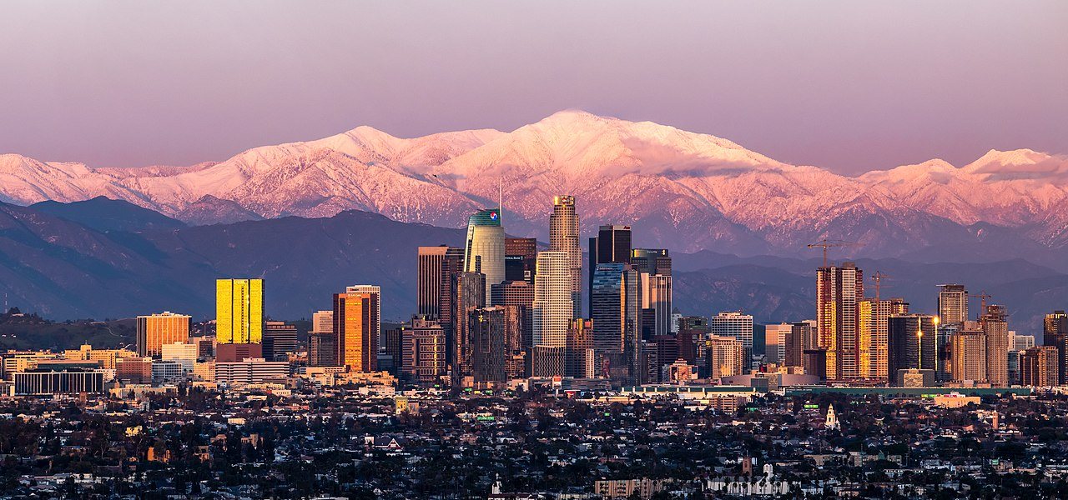
Los Angeles: City of Angels
你见过凌晨四点的洛杉矶吗？

Slide 27
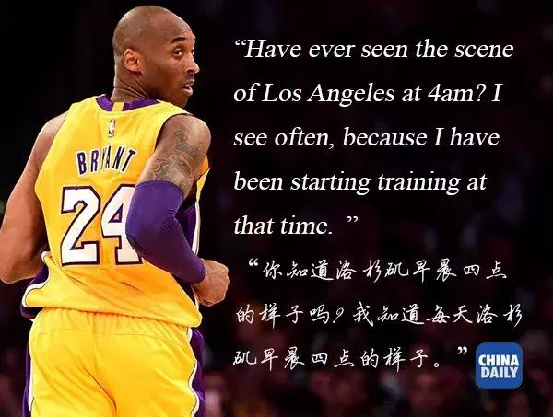
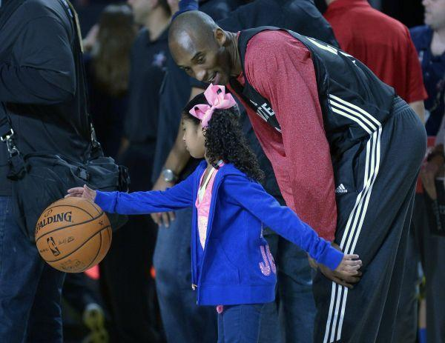

Slide 28
Los Angeles Lakers
Hollywood
There are three public universities within the city limits.

Slide 29
3 This winter, I took a trip to Los Angeles to do an internship⁹. I wanted to find the perfect piece to personalize¹⁰ my “work” outfits. I tried on necklaces, jackets, glasses, and hats, and really liked some of them, but when I tried them on, I didn’t get the rush¹¹ of excitement and empowerment¹² that I feel when I put together a perfect outfit. There was just something that was missing.
★ internship /'ɪntɜːnʃɪp/
n. （学校或毕业生的）实习期
★ rush /rʌʃ/ n. （强烈感情的）迸发，涌动
★ personalize /'pɜːsənəlaɪz/
v. 为个人特制或者专设
How would the author feel when she didn’t have a perfect outfit?
She would fail to get the rush of excitement and empowerment and felt that there was something that was missing.

Slide 30
3 This winter, I took a trip to Los Angeles to do an internship⁹. I wanted to find the perfect piece to personalize¹⁰ my “work” outfits. I tried on necklaces, jackets, glasses, and hats, and really liked some of them, but when I tried them on, I didn’t get the rush¹¹ of excitement and empowerment¹² that I feel when I put together a perfect outfit. There was just something that was missing.
Main idea of the parts:
internship
The author did an in Los Angeles this winter and wanted to find the perfect piece
to her “work” outfits. However, she failed to do that. She didn’t get the feeling of excitement and empowerment because she couldn’t find a perfect piece.
personalize

Slide 31
★ try on 试穿
e.g. Let the little girl try on as many as she likes.
4 After trying on almost everything from the jewelry section, I was about to give up, and then a quirky¹³ flower crown¹⁴ caught my eye. I think a part of me knew right away that it was going to go to LA with me. I placed it on my head and it was like putting down the last piece of a puzzle¹⁵. I felt complete; I felt happy, strong and powerful¹⁶; I felt like me!
★ powerful /'paʊəfl/ adj.
(a) （人或组织）有权势的；有影响力的
e.g. an immensely powerful organization 有巨大影响力的组织
a rich and powerful man 一个有钱有势的人
(b) 强有力的；力量大的
e.g. powerful weapons 威力强大的武器
a powerful voice 洪亮的嗓音
★ puzzle /'pʌzl/ n. 谜语；智力游戏
★ quirky /'kwɜːki/ adj. 奇特的；离奇的
How did the author feel when
she placed the flower crown on her head?
★ crown /kraʊn/ n. 王冠；帽子
★ give up 放弃
e.g. She doesn’t give up easily

Slide 32
4 After trying on almost everything from the jewelry section, I was about to give up, and then a quirky¹³ flower crown¹⁴ caught my eye. I think a part of me knew right away that it was going to go to LA with me. I placed it on my head and it was like putting down the last piece of a puzzle¹⁵. I felt complete; I felt happy, strong and powerful¹⁶; I felt like me!
jewelry section
crown
The author placed the flower which is from the on her head and it was just like putting down the last piece of a .
puzzle

Slide 33
3 This winter, I took a trip to Los Angeles to do an internship⁹. I wanted to find the perfect piece to personalize¹⁰ my “work” outfits. I tried on necklaces, jackets, glasses, and hats, and really liked some of them, but when I tried them on, I didn’t get the rush¹¹ of excitement and empowerment¹² that I feel when I put together a perfect outfit. There was just something that was missing.
4 After trying on almost everything from the jewelry section, I was about to give up, and then a quirky¹³ flower crown¹⁴ caught my eye. I think a part of me knew right away that it was going to go to LA with me. I placed it on my head and it was like putting down the last piece of a puzzle¹⁵. I felt complete; I felt happy, strong and powerful¹⁶; I felt like me!
Main idea of this part
After trying on almost everything, the author finally found the right thing with her to LA. That made her happy and powerful.

Slide 34
5 This is the feeling I get when I know that a piece of clothing is just right. Everyone should know what it feels like to be honestly themselves, especially when we don’t really know who we are yet. Clothes can be a powerful tool for figuring¹⁷ it out.
★ figure /'fɪgə(r)/ v. 计算；认定
★ figure out
to think about sb. / sth. until you understand them / it
弄懂；弄清楚；弄明白
e.g. I can’t figure out how to do this.
我不清楚怎么做这件事。
(b) to calculate an amount or the cost of sth. 计算（数量或成本）
e.g. Have you figured out how much the trip will cost?
旅行要花多少费用你算出来了吗？

Slide 35
6 I want everyone who doesn’t feel like they have a voice, to find a voice through their style. I want everyone who feels a little lost, to be able to discover a part of themselves when they try on clothes they love. I want everyone to experience the power that comes from loving how you look, and not because you look like a model¹⁸, or an actress¹⁹, or the way a magazine told you should look this season.
★ model /'mɒdl/ n. 模特
★ actress /'æktrəs/ n. 女演员
Main idea of this part
The suggestions the author gave about fashion.

Slide 36
7 For me, fashion has been a comfort and a challenge, a source²⁰ of inspiration²¹ and empowerment, and a method for self-expression and discovery and I want to share that with YOU!
★ inspiration /ˌɪnspə'reɪʃn/ n. 灵感；妙计
★ source /sɔːs/ n. 来源，出处
★ share with 分享
e.g. Now I’d like to share with you the excitement.
Main idea of this part
What fashion means to the author.

Slide 37
5 This is the feeling I get when I know that a piece of clothing is just right. Everyone should know what it feels like to be honestly themselves, especially when we don’t really know who we are yet. Clothes can be a powerful tool for figuring¹⁷ it out.
6 I want everyone who doesn’t feel like they have a voice, to find a voice through their style. I want everyone who feels a little lost, to be able to discover a part of themselves when they try on clothes they love. I want everyone to experience the power that comes from loving how you look, and not because you look like a model¹⁸, or an actress¹⁹, or the way a magazine told you should look this season.
Main idea of this part
Clothes can be a powerful tool to speak for people and fashion can be a method to help them discover themselves.
7 For me, fashion has been a comfort and a challenge, a source²⁰ of inspiration²¹ and empowerment, and a method for self-expression and discovery and I want to share that with YOU!

Slide 38
Main idea of the text
Text A tells us that fashion can give people a and . Clothes can be a more powerful tool to people than a good score on a test. In the text, the author also gives examples to tell readers the and she gets from fashion. For the author, fashion has been a comfort and a challenge,
a source of and , and a method for self-expression and discovery.
voice
confidence
speak for
excitement
empowerment
inspiration
empowerment

Slide 39
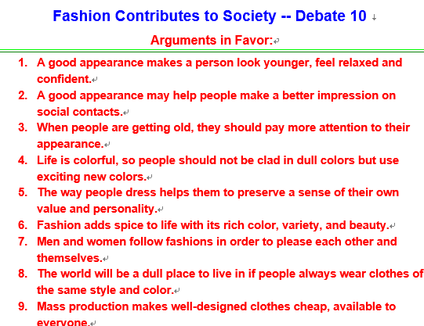

Theme exploration
Critical thinking
the benefits of fashion?

Slide 40
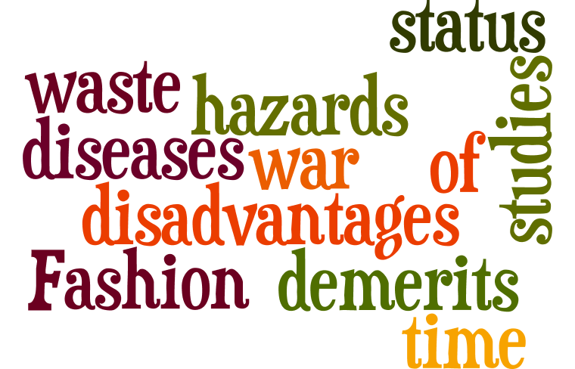
some major drawbacks and demerits of fashion
(i) It is uncomfortable e.g to wear hip and stylish designs.(like the models who walk on runways in fashion shows often stumble and fall down on runway)
(ii) Men's fashion can also be restrictive and uncomfortable.(like wearing suit jackets and neckties)
(iii) Fashion can consume money and resources that could be put to uses that help society more. Fashion may also be out of reach to some people.(usually people can’t afford it)
(iv) Women have become a piece of show in advertisements.
(v) Fashionable is also a status war in itself.
(vi) Older children can feel pressured to grow up too fast.
(vii) It has a limited time, because it changes rapidly.
(viii)It deviates youngsters from studies.
(ix) At schools, girls have started to rank themselves with fashion.

Slide 41
It has a limited time, because it changes rapidly.
fast fashion
The economics
According to the Ellen McArthur Foundation, clothing production has approximately doubled in the last 15 years, driven by a growing middle-class population across the globe and increased per capita sales in developed economies. An expected 400 per cent increase in world GDP by 2050 will mean even greater demand for clothing. This could be an opportunity to do better. One report found that addressing environmental and social problems created by the fashion industry would provide a $192 billion overall benefit to the global economy by 2030. The annual value of clothing discarded prematurely is more than $400 billion.

Slide 42
The environmental impacts
Apparel production is also resource- and emissions-intensive. Consider that:
•Making a pair of jeans produces as much greenhouse gases as driving a car more than 80 miles
•Discarded clothing made of non-biodegradable fabrics can sit in landfills for up to 200 years.
•It takes 2,700 liters of water to make one cotton shirt, enough to meet the average person’s drinking needs for two-and-a-half years. Addressing environmental and social problems created by the fashion industry would provide a $192 billion overall benefit to the global economy by 2030.

Slide 43
style, teenager, outfit, internship, personalize, quirky, inspiration.
The golden autumn light provided the for the painting.
inspiration
The magazine is aimed at and young adults.
teenagers
She had done little to her room, except hang a few posters on the walls.
personalize
style
Jones favours a dynamic, hands-on of management.
He was tall and had a , off-beat sene of humour.
quirky
internship
Jane has a summer at a local TV station.
outfit
I'm going to wear my vampire for Halloween.

